Slide 1
Finding NYC's neighborhoods which will benefit the most out of building a medical service nearby them
Ariel Nisenbaum
October, 2019

Slide 2
The problem
A medical emergency is an acute injury or illness that poses an immediate risk to a person's life or long-term health
For emergencies starting outside medical care, a key component that can make a difference between life and death is the response time – i.e. the time frame in which the medical emergency start till the emergency medical services arrival
As a result, geographers have been increasingly involved in emergency medical-services planning. Of particular importance has been the application of location-optimization models that minimize ambulance response time. Therefore, it is necessary to geographers to know which neighborhood will be benefit the most out of building a medical service nearby them
Focusing in New York City, our aim in this project is to find out which neighborhoods have the biggest response time, i.e. – finding the neighborhoods that their distance to a nearby medical service is the largest.

Slide 3
Required data
Since the main feature to investigate is distance, our data sets will only need to contain medical centers coordinates and neighborhoods coordinates (latitude and longitude) in New York City
For the neighborhoods data set we can use the following link:
https://cocl.us/new_york_dataset
For the hospitals data set we can use the following data from Wikipedia:
https://en.wikipedia.org/wiki/List_of_hospitals_in_Manhattan
https://en.wikipedia.org/wiki/List_of_hospitals_in_the_Bronx
https://en.wikipedia.org/wiki/List_of_hospitals_in_Brooklyn
https://en.wikipedia.org/wiki/List_of_hospitals_in_Queens
https://en.wikipedia.org/wiki/List_of_hospitals_in_Staten_Island

Slide 4
The chosen model – dbscan
Clustering model
Sensitive to density
Taking the distance into account
Clusters which not contain hospitals\medical centers will be neighborhoods that will benefit the most out of building a nearby hospital\medical center
outliers will be also neighborhoods that will benefit the most out of building a nearby hospital\medical center

Slide 5
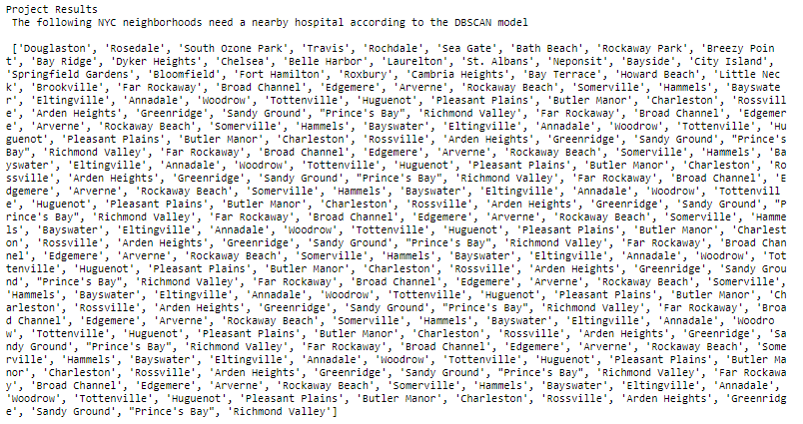
Results and observations
For choosing epsilon = 0.025 and n_samples = 5, we got that the following neighborhoods are the ones that will benefit the most out of building a nearby hospital\medical center

